Slide 1
Shifting Trends in Patent Litigation
Texas IP Law Journal Symposium
Ahimsa Hodari and Zac Loney
March 1, 2024

Slide 2
Who’s Who
Ahimsa Hodari
Zachary Loney

Slide 3
Executive Summary
This presentation will begin at a high level, including explaining some basic topics such as patent prosecution and patent litigation before diving deeper into how the landscape is evolving by discussing a few specific trends. We intend to discuss the patentability of AI and Blockchain technologies, recent changes in how traditionally defensive patent holders have prioritized monetization of their patent portfolios, and the shift in the litigation landscape in terms of the rising occurrence of litigation funders and their impact on which entities are suing and being sued for patent infringement.

Slide 4
Roadmap
Patent Prosecution and Litigation Overview
Common Patent Venues
Industry Trends - Who’s Suing Who?
Litigation Deep Dive:
Monetization of Patent Portfolios
Patenting and Protecting AI and Block Chain Innovations
Q&A

Slide 5
What is Patent Prosecution?
The process of drafting, filing, and negotiating with the USPTO to obtain patent protection and rights for an invention
Governed by Title 35 U.S.C.; patent term is ~20 years from filing
Types of patents – design, utility, or plant
Types of claims – method or apparatus
Notes:
The type of patent and the type of claims depend on what you are attempting to protect.
Each patent must be a single type, design, utility, or plant.
We will focus on utility patents today since they make up the vast majority of patent application and issued patents. Plant patents and design patents have unique sections of law protecting them.
A utility patent may have multiple claims of different types.
For example, when patenting a pharmaceutical compound, one claim may cover the actual method of delivery (i.e., pill, shot, etc.) while another claim may cover the manner of method for making the compound.

Slide 6
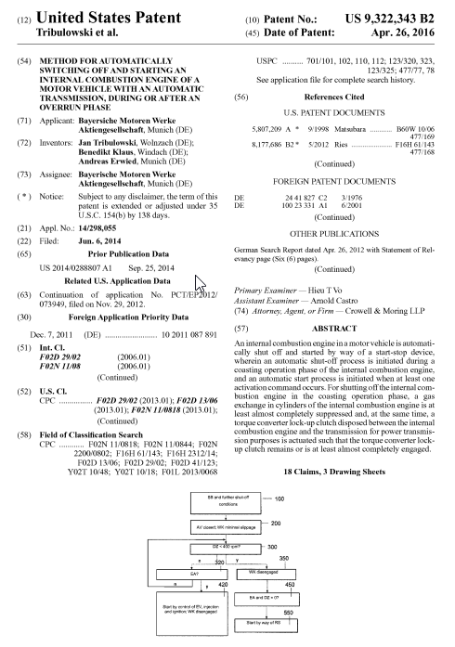
Patents & Patent Applications
Patent Eligibility
35 U.S.C. § 101 - Patent Eligible Subject Matter
“Whoever invents or discovers any new and useful process, machine, manufacture, or composition of matter, or any new and useful improvement thereof, may obtain a patent therefor” (emphasis added)
BUT, not a judicial exceptions (i.e., abstract ideas, laws of nature, and natural phenomena)
35 U.S.C. § § 102 and 103 – Novelty and Obviousness
35 U.S.C. § 112 – Specification (Written Description)
Notes:
Take a step back, to obtain a patent, the invention must be
Directed to a tangible product or process
New, or “novel” (something not done before)
“Not obvious,” as related to a change to something already invented
Obtaining a patent does not require the inventor to have implemented the invention, but it must include a written description of the invention in clear and concise terms that would allow others in the field to make and use it.

Slide 7
Patent Protection Considerations
Benefits and Tradeoffs
Right to exclude others from making or using the invention for a fixed length of time
Obtain payment or rent from others for their use of your invention
Invention and how to make it is disclosed to the public
Public may “design-around” the invention to obtain the same or similar benefits
Other Considerations
Post-AIA First-to-File Framework (vs. first-to-invent)
Notes:
Patents are constitutionally granted property rights based on an exchange between the government and the inventor.
- The government grants the inventor the right to exclude others from using the claimed invention
- The inventor agrees to disclose the invention to the public
Whether to pursue patent protections and how to do so often hinges on whether this exchange benefits the inventor or not.
Post-AIA First to File Framework took effect with AIA, effective March 2013

Slide 8
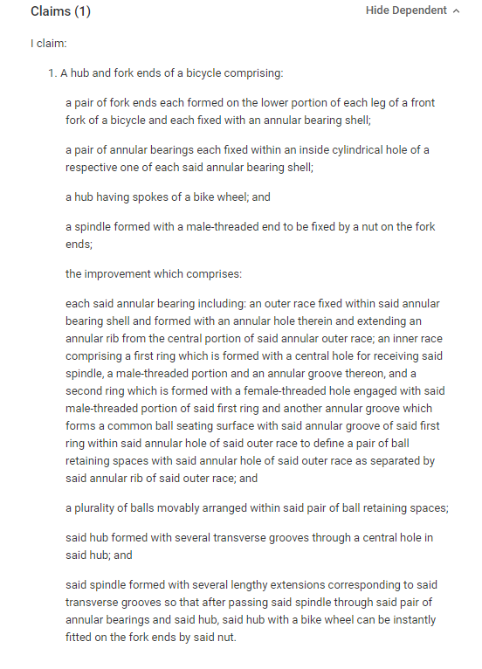
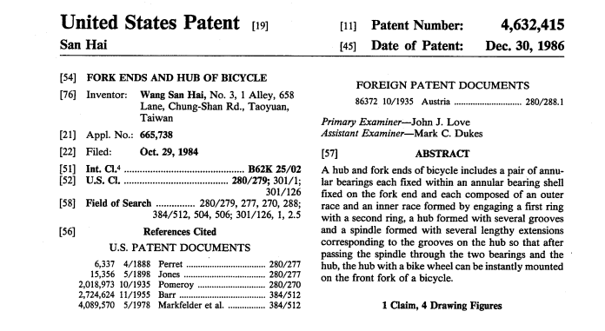
Anatomy of a Patent
Notes:
Patents are, at their heart, legal documents with the information structured in a specific format. At a high level, a patent will include an Abstract, a Background Section, a written description of the invention, and the claims.
The claims define the legally protectable scope of the invention. Typically, if it is not in the claims, it is not protected by the patent. When writing claims there is a tradeoff between the level of description used and the patentability of the invention.
The more generic the claims, the more uses they would potentially cover but the more susceptible they are to patentability challenges. The more specific the claims, the more likely they are patentable but may not cover as many possible uses.
For example, in the patent here, the spindle must be fixed to the fork ends “by a nut.” That is a very specific method of joining the items. The claims could have instead said that the spindle is fixed to the fork ends “by a means for connecting.” The latter would broaden the patent to include bicycles that join the two parts using welds, screws, or any many of other methods.

Slide 9
What is Patent Litigation?
You have a patent, now what?
Identify potential infringement (or simply conduct your business)
35 U.S.C. § 271 - Anyone who “without authority makes, uses, . . . or sells any patented invention”
Engage potential infringers (e.g., letters, licensing discussions, or filing a lawsuit)
Unique Aspects of Patent Litigation
Theories of infringement (plaintiff), invalidity (defendant), and damages (both)
Claim Construction / Markman Hearing
Concurrent litigation in other venues
Notes:
Once the patent is granted, then what?
A patent holder might seek to identify potential infringers. The ease or difficulty of this stage depends on the invention and how the claims are written. For example, an invention for a physical system or component may be easily identifiable by purchasing a competitor’s product and examining it. Alternatively, something like software may be much more difficult to identify, where you may understand certain inputs and outputs but do not have full visibility into how one produces the other.
Note – not all patent holders go on the offensive regularly (meaning, they will if needed, but they are often on the defensive).
Likewise, whether an entity is sued depends on the claims. The claims could be directed to target any combination of the entity that makes the product, the entity that provides or sells the product, and the entity that uses the product (the end user).
Once identified, the patent owner engages the potential infringers, which may eventually lead to litigation.
Patent litigation is similar but also very distinct from many other types of litigation.
- For example, a plaintiff’s theory of infringement is straightforward. It focuses on what actions allegedly infringe. To which a defendant typically responds by identifying the aspects of the patent they do not use.
- On the other hand, a defendant’s theories of invalidity can take many forms. As noted above, the defendant can argue the patent is invalid for ineligible subject matter under 101, as not novel under 102, as obvious under 103, or as lacking adequate written description under 112. Numerous other theories are also possible including waiver, license, laches, and inequitable conduct.
- Lastly, the damages calculations in patent cases follow particular structures identified in the case law. While we will not go into them today, the final damages numbers are typically presented as either a royalty rate for each accused product sold or a lump sum.
Patent litigation also includes something called claim construction, during which the parties identify language in the patent claims that they disagree to its meaning. This step is often just as important as the others because it can support or damage a party’s theories of infringement or invalidity.
Lastly, patent’s may be litigated in different venues, which often progress at different paces and may or may not be binding on the other venues.

Slide 10
Common Patent Venues
Federal Court
PTAB
(Patent Trial and Appeal Board)
ITC
(International Trade Commission)
Typical scenario
Request of damages and/or injunctive relief
Considers questions of validity, infringement, and damages
Usually (but not always) the slowest path to a final determination
Post-Grant Procedures
Inter partes review (IPR)
Post Grant Review (PGR)
Ex-Parte reexamination
Determine whether a granted patent is unpatentable or not (often referred to as validity / invalidity)
Quick (18 months from filing to final decision)
Focused on importation of allegedly infringing goods
No money damages; exclusion orders
Determines both patentability and infringement
Quick (15-18 months from filing to final decision)
Notes:
Types of review vary based on different grounds for declaring something unpatenable (i.e.: anticipation, obviousness (statutory grounds) vs other grounds like public-use, on-sale activity, etc.) as well as timeframe for when you can initiate the review
- For the Ex-Parte Reexamination, must be able to show that one or more claims for the patent are based on a “substantial new question of patentability.”
- An inter-partes review may be instituted upon a showing that there is a reasonable likelihood that the petitioner would prevail with respect to at least one claim challenged. IPRs resemble more of a classic courtroom procedure
- Post-Grant Review: Any third party can file for a PGR on the basis that it is “more likely than not” that the claim against the patent will be substantiated (“reasonable likelihood” is the basis for an IPR).

Slide 11
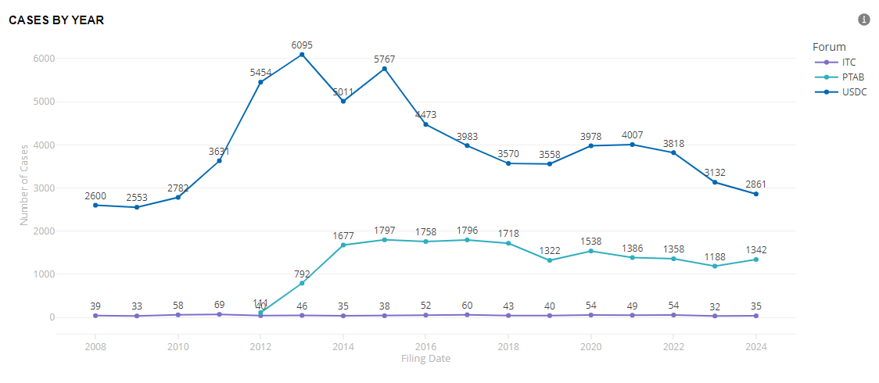
Common Patent Venues – By the Numbers
Source: Docket Navigator, accessed on 1/31/2024
Notes:
80% times less likely to see ITC cases vs district court cases

Slide 12
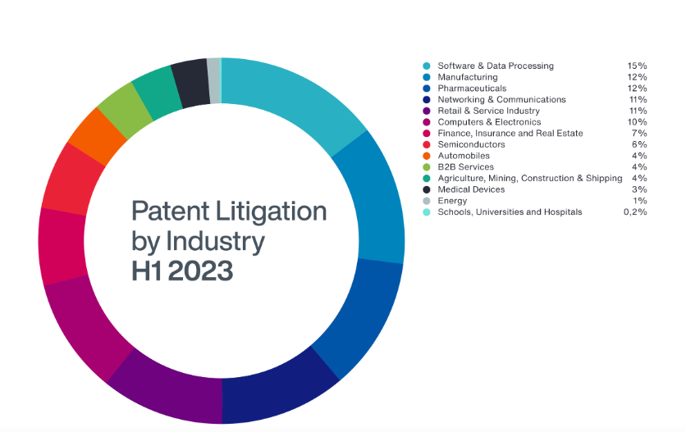
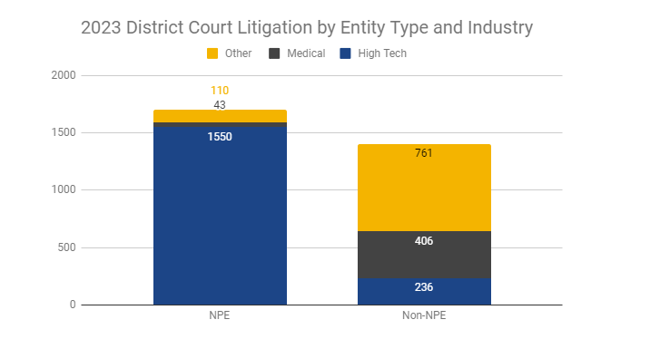
Patent Litigation by Industry
Source: Patent Dispute Report: 2023 in Review — Unified Patents, accessed 2/23/2024
NPEs are entities that do not make products or offer services. PAEs—often called “patent trolls”—are NPEs that employ patents primarily to obtain license fees, rather than to support the transfer or commercialization of technology.
Source: How Current IP Patent Litigation Trends are Changing Risk Exposures (aon.com), accessed 2/7/2024
Source: Welcome to the Stanford NPE Litigation Database | NPE Litigation Database, accessed 2/28/2024
Notes:
How Current IP Patent Litigation Trends are Changing Risk Exposures (aon.com)

Slide 13
Litigation Deep Dive

Slide 14
Patent Litigation Trends Related to Monetization

Slide 15
Asserting Patent Litigation – Trends Over Time
Manufacturer v Manufacturer
NPE v Manufacturer
NPE (via 3PP Lit Funder) v Manufacturer
Yesterday
Today
Tomorrow

Slide 16
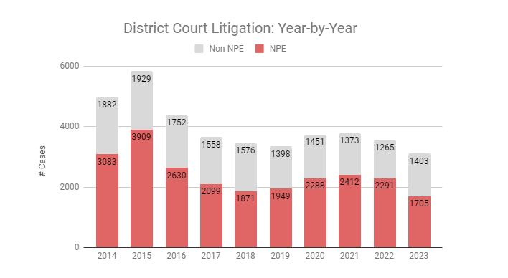
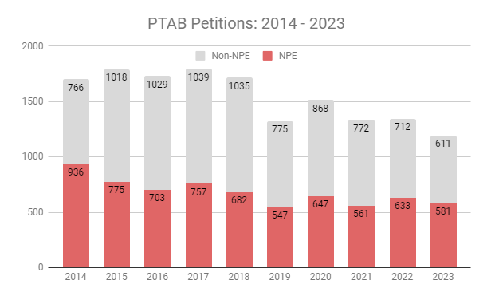
Asserting Patent Litigation – Trends Over Time
Manufacturer v Manufacturer
NPE v Manufacturer
NPE (via 3PP Lit Funder) v Manufacturer
Yesterday
Today
Tomorrow
Percentage of cases initiated by manufacturers has decreased over time in District Court and increased over time before PTAB.
Source: Patent Dispute Report: 2023 in Review — Unified Patents, accessed 2/23/2024
Notes:
Methodology
This report includes all District Court and PTAB litigations between January 1, 2015 and December 31, 2022 .
Total number of reported cases can vary based on what is included. Unified made its best attempt to eliminate mistaken, duplicative, or changes in venue filings, hence the totals may vary slightly compared to other reporting entities. Statistics include litigations initiated by NPEs or Declaratory Judgments (DJs) initiated by operating companies against NPEs.
Unified strives to accurately identify NPEs through all available means, such as court filings, public documents, and product documentation.

Slide 17
Asserting Patent Litigation – Trends Over Time
Manufacturer v Manufacturer
NPE v Manufacturer
NPE (via 3PP Lit Funder) v Manufacturer
Yesterday
Today
Tomorrow
Source: 2023 Litigation Annual Report | Unified Patents, accessed 2/23/2024
Notes:
Patent Dispute Report: 2023 in Review — Unified Patents
Source: Q4 in Review: NPE Litigation Gap Narrows as Top SEP Venues Compete for Jurisdiction | RPX Corp, accessed 2/23/2024

Slide 18
Asserting Patent Litigation – Trends Over Time
Manufacturer v Manufacturer
NPE v Manufacturer
NPE (via 3PP Lit Funder) v Manufacturer
Yesterday
Today
Tomorrow
Source: 2023 Litigation Annual Report | Unified Patents, accessed 2/23/2024
Notes:
IP Edge is the reason for this drop off → NPE Filings Decreased in 2023 Due to IP Edge Standstill and West Texas Downturn | RPX Corp on 2/23/24
The decrease in NPE litigation observed in 2023 does not appear to reflect a general trend. Rather, as RPX has previously reported, the drop was primarily caused by two notable developments in 2022. The most impactful of those developments was a pause in litigation by the large set of plaintiffs with ties to patent monetization firm IP Edge LLC (hereinafter, “IP Edge”). Those plaintiffs stopped filing new complaints starting in December 2022 as a result of pressure over transparency and corporate disclosures in Delaware, where Chief Judge Colm F. Connolly pursued information on the firm’s secretive entity formation strategy in a contentious, drawn-out inquiry that lasted most of 2023. As detailed in RPX’s latest quarterly report, Judge Connolly has since concluded as a result of that investigation that IP Edge, a related consulting firm, and the attorneys behind them engaged in a litany of misconduct.

Slide 19
Transparency Re: Third Party Litigation Funding
Trend
More courts are requiring transparency with respect to disclosure of third-party litigating funding received
Jurisdictions
Delaware
Judge Colm F. Connolly – introduced a standing order in April 2022 requiring disclosure
IP Edge LLC
New Jersey, Florida, California
Texas
Prohibited parties from asking for funding information
Implications
Shift in where litigation is filed; change in litigant composition
Notes:
Not Just Delaware: Litigation Funding Transparency Progress Across Multiple States - Patent Progress
In April 2022, Delaware federal court Chief Judge Colm F. Connolly introduced a standing order requiring that all parties appearing before him disclose any third-party funding they receive. Over the last two years, Judge Connolly has peeled back the layers on non-practicing entities IP Edge LLC and Mavexar LLC, required IP Edge-linked entity Nimitz Technologies to comply with the transparency order, caused Backertop Licensing LLC to dismiss what appears to have been a meritless patent infringement claim, and uncovered a China-based investment entity backing a lawsuit in his courtroom.
Almost a year before Judge Connolly introduced his standing order, Chief Judge Freda L. Wolfson of the District Court of New Jersey adopted Local Civil Rule 7.1.1, which requires all parties to disclose third-party litigation funding (TPLF) arrangements, including a description of the funder’s financial stake in the case.
In Florida, the Senate Committee on Fiscal Policy approved SB 1276, a bill that would require the “court’s consideration of potential conflicts of interest which may arise from the existence of a litigation financing agreement” and require “certain disclosures related to litigation financing agreements and the involvement of foreign persons, foreign principals, or sovereign wealth funds.”
In California, there have also been pushes to increase funding transparency–both by lawmakers and in district court. In 2005 and 2017, respectively, the Central District of California and the Northern District of California adopted local rules requiring disclosure of the primary objectives of the patent system. In return for the government-granted right to exclude that is embodied in the patent, the inventor must disclose to the public through his patent the invention for which protection is sought. Inventors unwilling to disclose their invention to the public may instead opt for trade secret protection. of third-parties in civil litigation.
Texas has done the opposite. In fact, the Eastern and Western Districts of Texas have actively prohibited parties from asking for funding information.

Slide 20
Traditionally Defensive Litigants Monetizing Patents
Trend
Parties traditionally on the defensive side of litigation are monetizing their patent portfolios via licensing, royalties, and patent sales
Factors
Financial pressure
COVID
Rise in 3PP Litigation Funders
Change in outcomes at the PTAB and district court in favor of patent owner
Implications
3PP on both sides of litigation; decrease in litigation
Counseling clients on how this is different
Notes:
Many tech companies have traditionally maintained large patent portfolios to enhance company value and for defensive reasons—i.e. to dissuade competitors from filing suit. But monetizing these dormant patent assets—which can cost a great deal to simply maintain—may provide a solution during these difficult economic times. Tech Companies Should Strongly Consider Monetizing Their Patent Portfolios During the Economic Downturn (fbm.com) accessed on 2/5/24
In a typical litigation funding arrangement, the funder pays all or nearly all of the costs of litigation, including an agreed fraction of outside counsel’s fees. In exchange, both the funder and outside counsel receive a share of any recovery, with the balance going to the patent owner. This kind of arrangement could enable companies to generate significant revenues from their otherwise dormant patent holdings for substantially less risk. Id.
Counseling clients on how this is different: NPEs are more sophisticated now, many are backed by 3PP Lit funders, making litigation more expensive and riskier.

Slide 21
Patenting and Protecting Blockchain and Artificial Intelligence Technology

Slide 22
Patent Protections and Considerations for New Technologies
Blockchain
State of Blockchain Patents
Challenges to Patenting Blockchain Technology
Solutions and Tips
Pending Blockchain (patent) litigation
Artificial Intelligence
State of AI Patents
Use of AI in Patent Prosecution
Determining Inventorship
Other Considerations

Slide 23
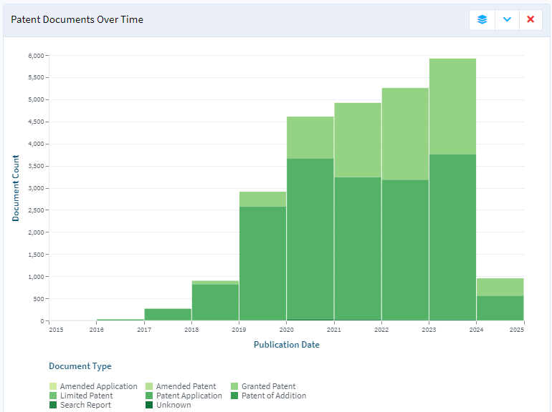
Is the Blockchain Patentable?
https://www.lens.org/lens/search/patent/analysis?q=blockchain,%20%22distributed%20ledger%22

Slide 24
Is the Blockchain Patentable?
What Has Been Patented?
Specific implementations: Wallets, Supply Chain, Identity
Methods of Use: Validation, Security, Identification
Protocols and Procedures: Blockchain protocols, consensus protocols, smart contracts
Examples
IBM – detecting drone attacks; flight data is recorded to identify patterns
OpenAI – AI models trained and operated on blockchain to provide tracking
Microsoft – open source blockchain architecture for private enterprises
PayPal – improvement on blockchain compression and storage procedures

Slide 25
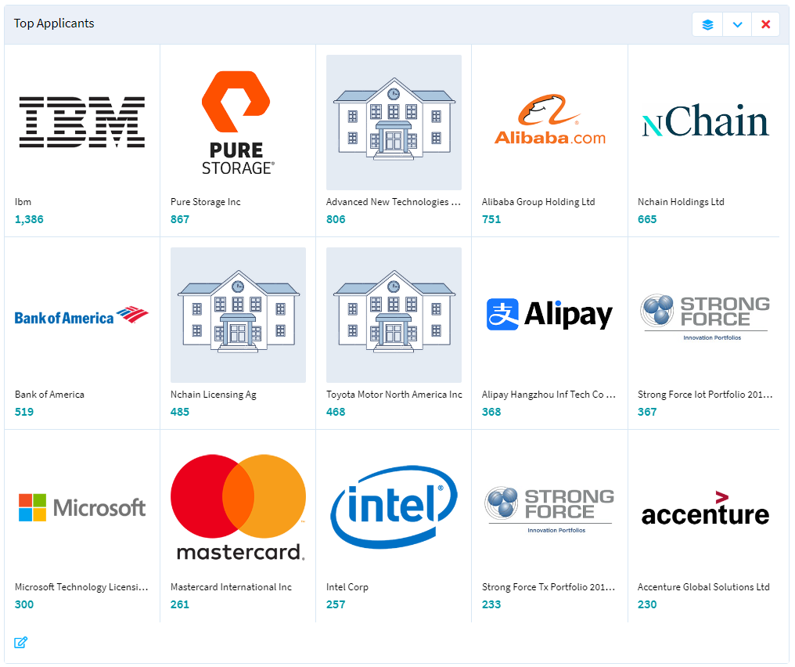
Who is Patenting Blockchain Technology?
Top Applicants
Top Owners

Slide 26
Challenges to Patenting BlockChain Technology
Locating Relevant Prior Art
Patent art is only a small portion of the prior art
But more are being published and granted as time goes on
Publicly available papers, protocols, and source code repositories
The level of detail in the papers and protocols varies widely
Extensive discussions of developments on other forums and in the media
Sites such as CoinDesk and others provide an insight into both the innovations in the field and the industries discussions of them
Functioning blockchain systems

Slide 27
Challenges to Patenting BlockChain Technology – § 101
Ex Parte Vijay Madisetti and Arshdeep Bahga, Appeal 2021-000148 (PTAB 2021)
“exchanging value across a blockchain network” using “a lending pool smart contract”
A specific abstract idea is still abstract, and its use cannot be inventive
Patent specification admitted the components were well-understood and routine
Rady v Boston Consulting Group, LLC et al., No. 1:2020cv02285 (S.D.N.Y. 2022)
Directed to “record to a blockchain the individual identification signatures of physical items that have unique random properties”
Abstract idea of “collecting, analyzing, and storing data”
Rejected argument that including a blockchain enhanced the computer functionality
“A blockchain is merely a ledger maintained and verified through a peer-to-peer network”
Appealed and oral arguments were heard on Feb. 9, 2024

Slide 28
Making it Patent Eligible
Claims should be written to avoid ineligible subject matter – § 101
Specification
Should identify the technical problem and its technical solution
Figures
Should include computer components, algorithms, and process flow charts
Claims
Should tie the invention to blockchain technology, not merely an idea

Slide 29
Making the Patent Useful
Can you identify infringement?
Private and Semi-Private blockchains
Shielded Communications
Claims should be written from the perspective of a potential infringer
End User
Intermediary (wallet, node, etc.)
Protocol provider

Slide 30
Blockchain Patent Litigation
Veritaseum Capital, LLC v. Coinbase Global et al. / Veritaseum Capital, LLC v. Circle Internet Financial Limited et al.
Accusations against Coinbase and Circle running Ethereum’s Proof of Stake validators
Pardalis Technology Licensing, L.L.C. v. International Business Machines Corporation
Patents directed to an “immutable ledger” for supply chain distribution
Forte Labs, Inc. v. Pocketful of Quarters, Inc.
Declaratory judgement of invalidity for a gaming related blockchain patent

Slide 31
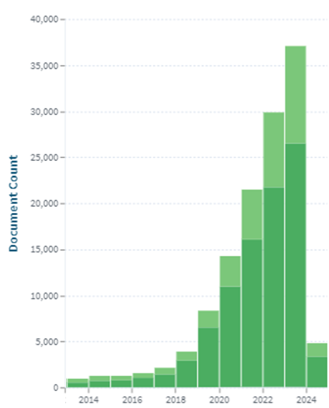
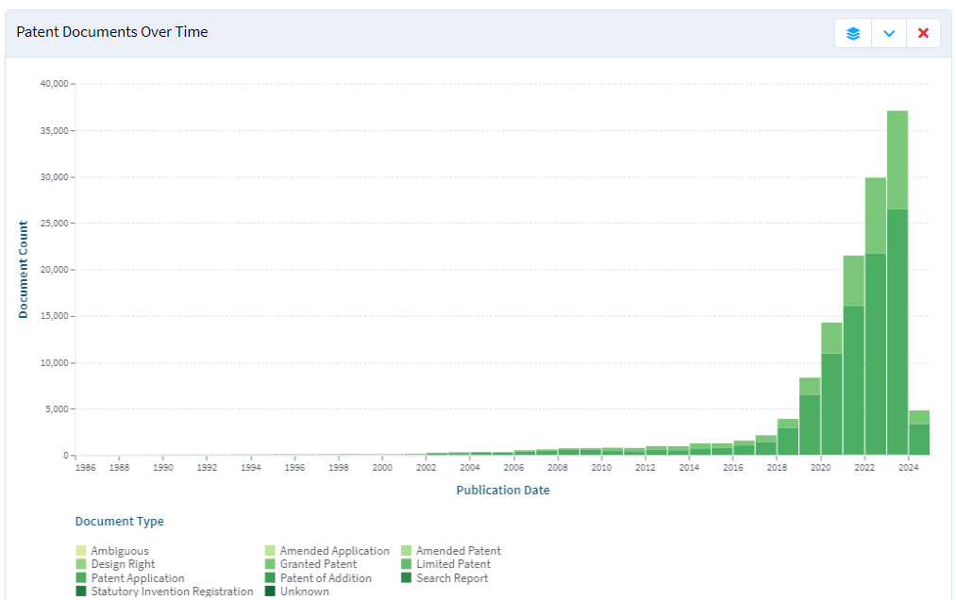
Patents and Artificial Intelligence
https://www.lens.org/lens/search/patent/analysis?q=(AI%20Artificial%20Intelligence

Slide 32
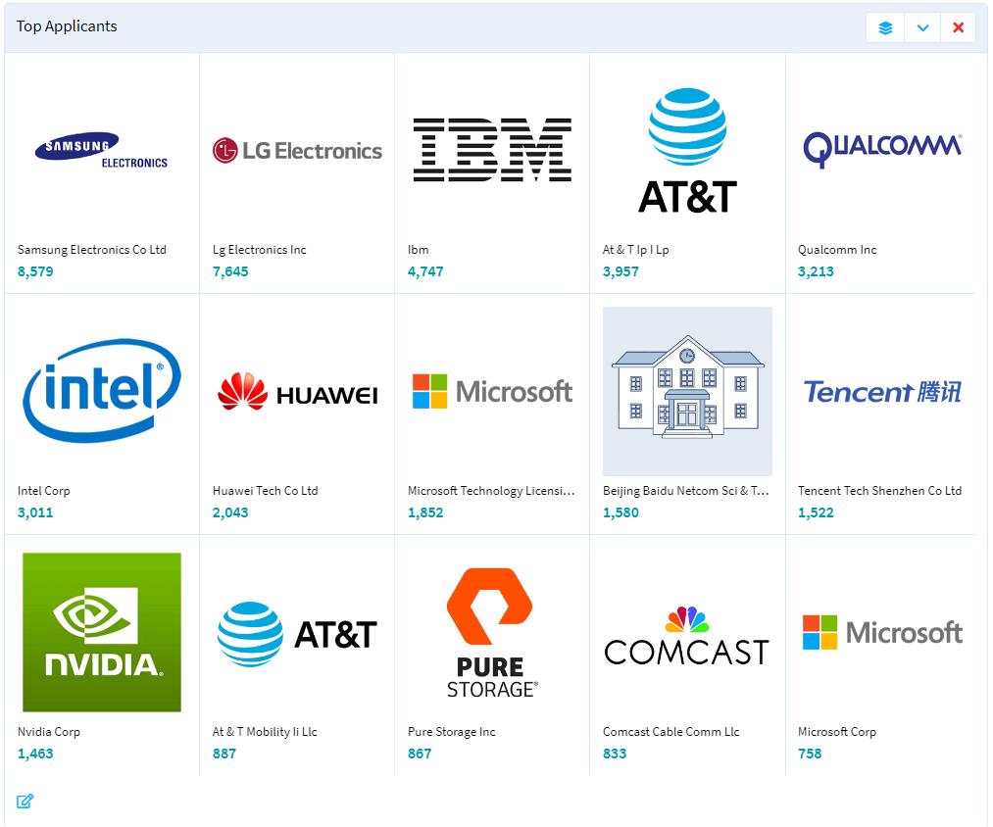
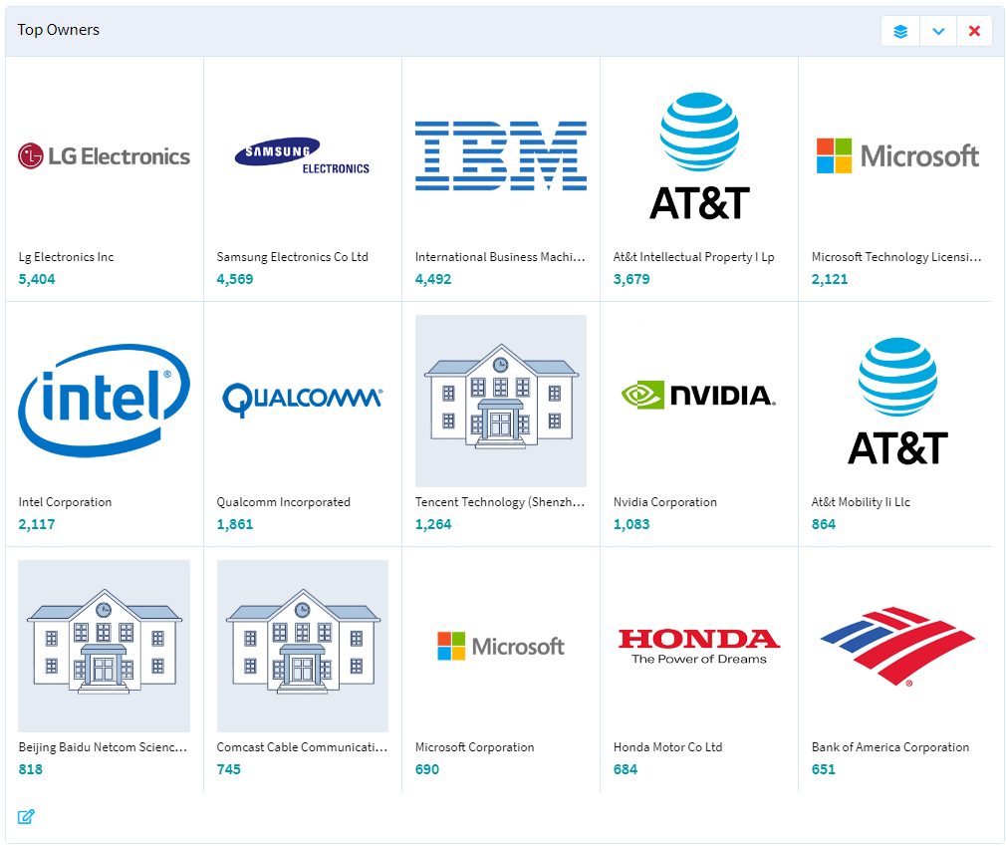
Who is Patenting Artificial Intelligence Technology?
Top Applicants
Top Owners

Slide 33
Who or What Can Be an Inventor?
AI cannot be an inventor.
Thaler v. Vidal, 43 F.4th 1207, 1209 (Fed. Cir. 2022), cert. denied, 143 S. Ct. 1783 (2023)
States cannot be inventors.
Univ. of Utah v. Max-Planck-Gesellschaft zur Forderung der Wissenschaften e.V., 734 F.3d 1315 (Fed. Cir. 2013)
Corporations cannot be inventors.
Beech Aircraft Corp. v. EDO Corp., 990 F.2d 1237, 1248 (Fed. Cir. 1993)
Inventorship limited to “natural persons”
Conception in the mind
Recognition of the novelty and use of the invention

Slide 34
USPTO Guidance on Using AI for Prosecution
Existing Rules and Procedures Are Sufficient
37 C.F.R. Part 11 – Representation of Others Before the USPTO
Applies regardless of how a submission is generated
Signatories certify that all statements are true or believed to be true
What It Means For Practitioners
Must know how it was created, including whether AI was used
Must Verify the accuracy of ALL factual and legal representations
“Simply assuming the accuracy of an AI tool is not a reasonable inquiry”
Potential Sanctions and Penalties
Striking the Paper; Precluding a party from presenting or contesting an issue; Terminate the Office proceedings
https://www.uspto.gov/sites/default/files/documents/directorguidance-aiuse-legalproceedings.pdf

Slide 35
Duty to Disclose Use of AI?
37 CFR 1.56
Duty of Candor and Good Faith, including the duty to disclose all known information that is material to patentability
This includes disclosures regarding improper inventorship
BUT
“At this time, to meet their duty of disclosure, applicants rarely need to submit information regarding inventorship. The USPTO does not believe this inventorship guidance will have a major impact on applicants' disclosure requirements.”
37 CFR 1.105
“If an examiner or other USPTO employee has a reasonable basis to conclude that one or more named inventors may not have contributed significantly to the claimed subject matter, the examiner or other USPTO employee may request information from the applicant regarding inventorship even if the information is not material to patentability

Slide 36
USPTO Guidance on Patenting AI-Assisted Technology
Inventorship
AI-assisted inventions are not categorically unpatentable
Question remains, “whether inventions made by human beings with the assistance of AI are eligible for patent protection”
Determining inventorship should focus on human contributions
Issues to Consider with AI-Assisted Technology
No Joint Inventorship with AI
How and when to identify whether AI systems were utilized in conceiving the invention
How and when to identify significant human contributes to AI-assisted invention
Subject Matter Eligibility
Obviousness and Disclosure

Slide 37
Determining AI-Assisted Inventorship
Example Scenarios and Guiding Principles
Provide a query to an AI system but do not alter output
Implement AI output without alteration
Experiment on AI output and add modifications
Use AI system to suggest alterations to an existing invention
Create or owns the AI system
https://www.federalregister.gov/documents/2024/02/13/2024-02623/inventorship-guidance-for-ai-assisted-inventions
https://www.uspto.gov/sites/default/files/documents/ai-inventorship-guidance-mechanical.pdf

Slide 38
Determining AI-Assisted Inventorship
Provide a query to an AI system but do not alter output
Merely recognizing a problem or having a general goal is not conception; must provide significant contribution
BUT
“[A] significant contribution could be shown by the way the person constructs the prompt in view of a specific problem to elicit a particular solution from the AI system”
https://www.uspto.gov/sites/default/files/documents/ai-inventorship-guidance-mechanical.pdf

Slide 39
Determining AI-Assisted Inventorship
Utilizing AI output without alteration
Reduction to practice is not a significant contribution by itself that would constitute inventorship
Using methods, components, and materials known to one of skill in the art
Does the method of reduction provide a substantial benefit to the invention or address a particular problem of the preliminary design?
https://www.uspto.gov/sites/default/files/documents/ai-inventorship-guidance-mechanical.pdf

Slide 40
Determining AI-Assisted Inventorship
Experiment on AI output and add modifications
Whether the level of experimentation was minimal or significant
Add not insignificant modifications from the AI output
Add significant additional elements not originating from the AI output
https://www.uspto.gov/sites/default/files/documents/ai-inventorship-guidance-mechanical.pdf

Slide 41
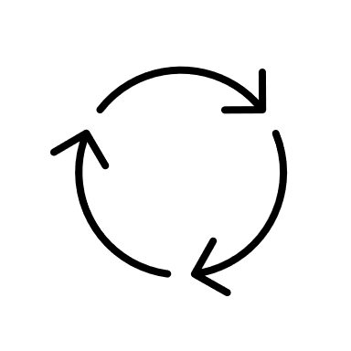
Determining AI-Assisted Inventorship
Use AI system to suggest alterations to an existing invention
Once a significant contribution is made inventorship is proper
Subsequent AI-assisted contributions do not negate the inventor’s contribution
https://www.uspto.gov/sites/default/files/documents/ai-inventorship-guidance-mechanical.pdf

Slide 42
Determining AI-Assisted Inventorship
Create or own the AI system
Maintaining intellectual control over an AI system does not, on its own, make that person an inventor of anything it creates
The owner or overseer must still make a significant contribution to the invention
BUT
A Person that designs, builds, or trains an AI system for a specific problem to elicit a particular solution may be an inventor if those acts are a significant contributions
https://www.uspto.gov/sites/default/files/documents/ai-inventorship-guidance-mechanical.pdf

Slide 43
AI and § 101
Ex parte Hannun (formerly Ex parte Linden), 2018-003323 (April 1, 2019)
Directed to a specific implementation for transcribing audio
normalizing, generating a jitter set, generating a set of spectrogram frames, obtaining character probabilities, and decoding using the predicted character probabilities.
Alice analysis
Not a mental process
Not organizing human activity
Not claiming a mathematical formula
Technical solution to a technical problem
Reversed § 101 and § 103 rejections

Slide 44
Questions Without Answers (so far)
Public Disclosure
Does use of a public AI tool render its output “otherwise available to the public” under 35 U.S.C. 102(a)?
Obviousness and Level of Ordinary Skill in the Art
Can knowledge and skill be supplemented with AI?
What level of AI-assistance is “obvious” vs. “non-obvious”
Prior Art
Using AI to create prior art

Slide 45
Takeaways for practical use
Use private AI tools, not public
Document design and training of AI system (if applicable) and problems to be solved
Document prompts and input to AI system
Document review, experimentation, and modification of AI output
For iterative processing, document the full process

Slide 46
Thank you
Ahimsa Hodari – ahimsa.hodari@us.dlapiper.com
Zachary Loney – zachary.loney@us.dlapiper.com

